Slide 1

Keysafe
Manuel Manco 0124002677
Manage your passwords easily

Slide 2
introduction
Nowadays, it’s getting harder to keep our accounts safe, using different passwords for each one. We often make the mistakes of creating passwords that are too simple and always use the same ones to avoid forgetting them. However, this could make it easier for many hackers to steal our data.

Slide 3
Proposed application
KeySafe is the right solution to these problems. It provides a simple user interface that helps you create random passwords which respects the parameters you set. Moreover KeySafe shows a list of all your saved passwords where you can copy, edit or delete them.

Slide 4
Security
KeySafe manages your passwords in a very safe way to prevent a possible data breach from revealing your passwords in clear, indeed, they are obfuscated before being saved in the database, using advanced encryption systems. Moreover, each KeySafe account is associated to a different encryption key so that only the owner can see his passwords.

Slide 5
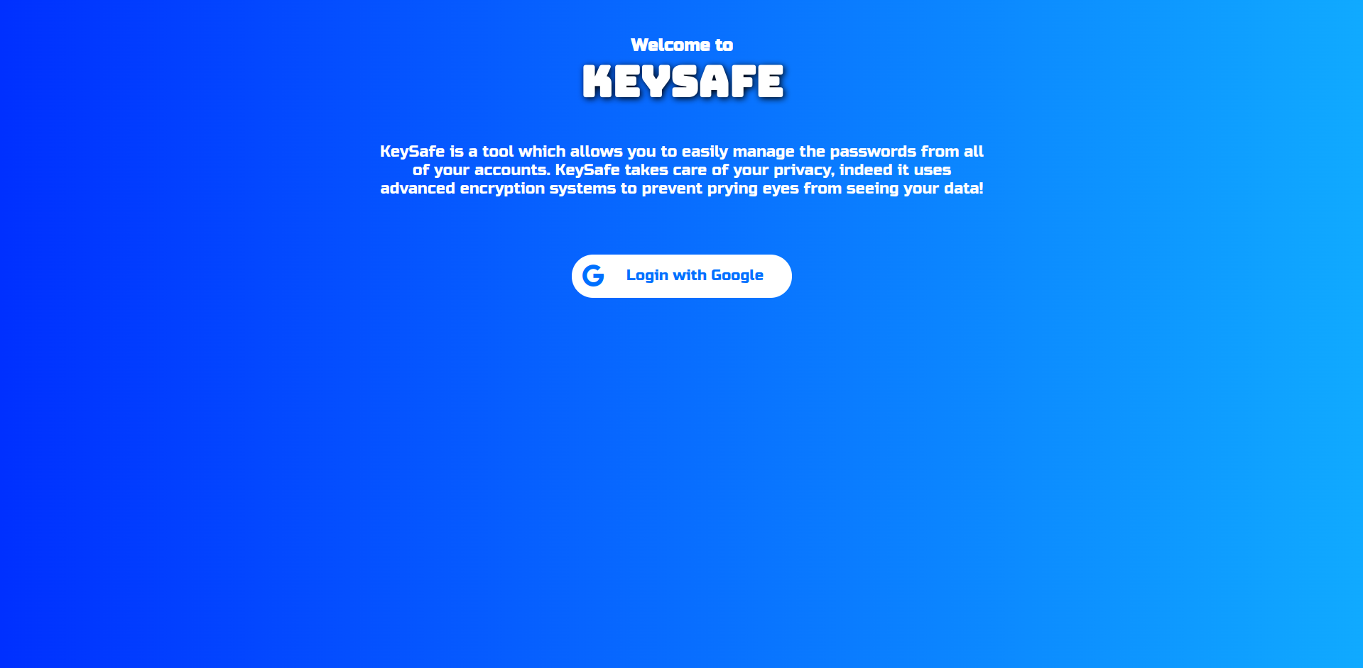
The home page of the website looks like this:
You can press the button to login using your Google account.

Slide 6
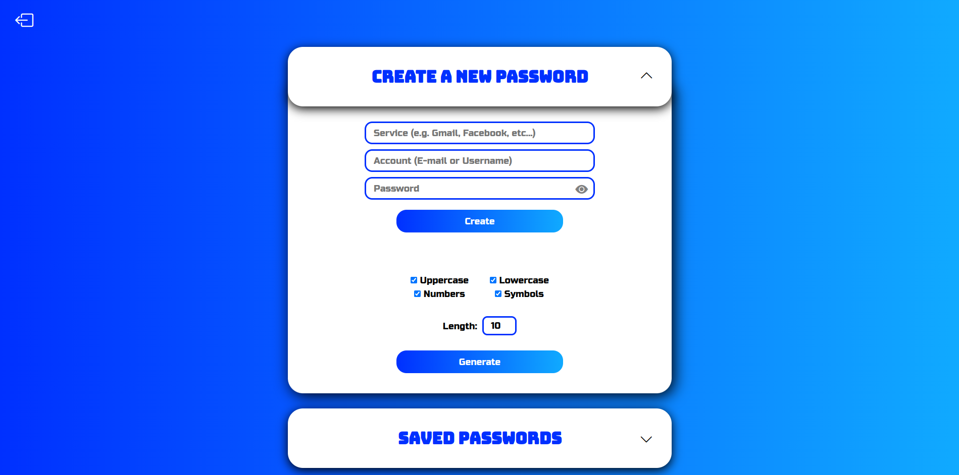
This is the dashboard, which is loaded once you have logged in:
Here you can create a new password or open the other , which contains all of your saved passwords.

Slide 7
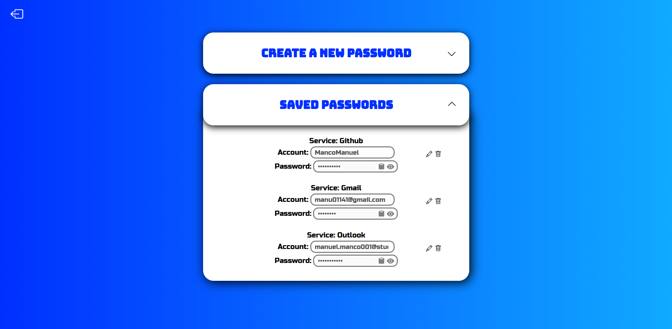
Here is an example of a list of passwords associated with a test account:
As you can see, here you are able to see in clear, copy, edit or delete any password.

Slide 8

The END
Thank you for the attention

